Slide 1
Osteosarcoma

Slide 2
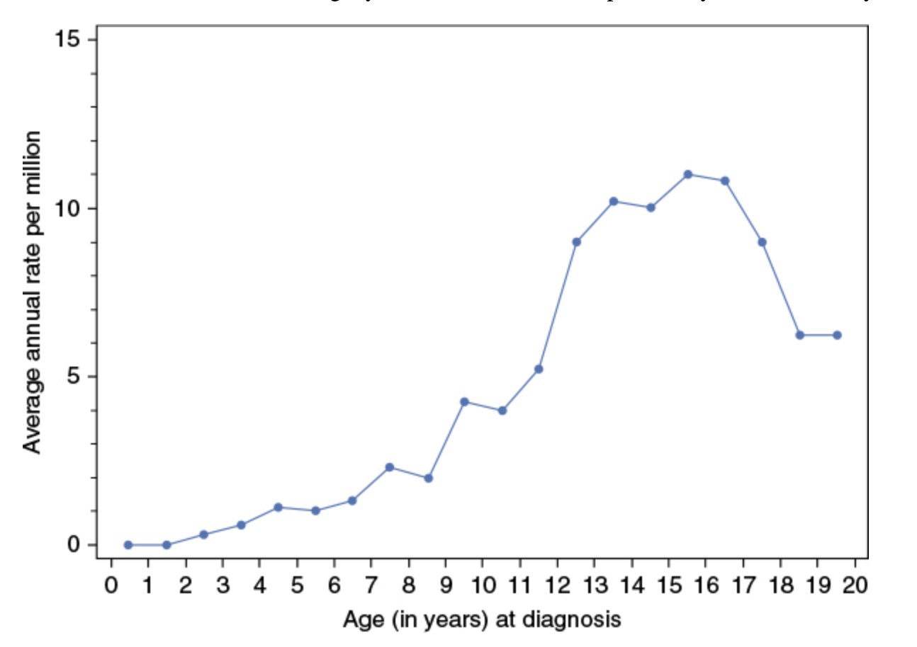
OS - Epidemiology
Osteosarcoma is the most common primary bone tumor in children
Peak during growth spurt
Notes:
A second peak in incidence, approximately half the magnitude of the adolescent peak, occurs in the sixth to seventh decades. Osteosarcoma in older patients is associated with Paget disease and prior radiation therapy
The age of peak incidence corresponds to the age of greatest growth velocity in each gender (girls 13, boys 16)

Slide 3
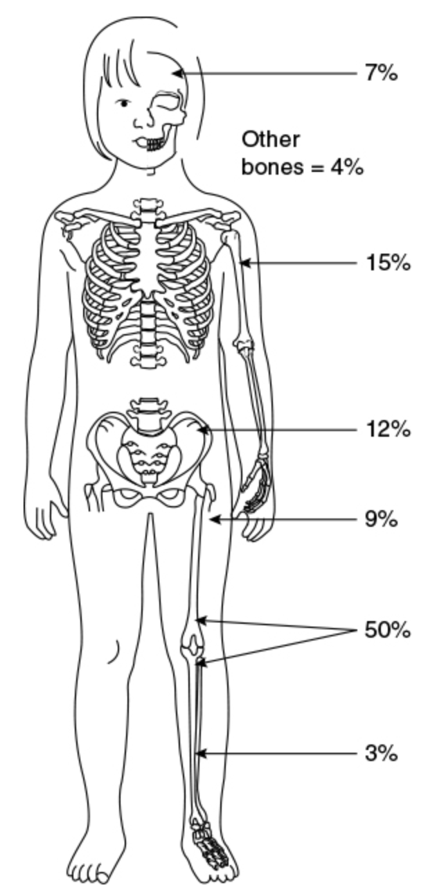
Although osteosarcoma can occur in any bone of the body, the majority occur in regions that undergo the most extensive longitudinal growth, particularly bones around the knee and the proximal humerus
Most common primary sites are
Distal femur (55%) > proximal tibia > proximal humerus
Osteosarcoma typically arises in the metaphyses of bones, which is the site where new bone arises from the growth plates
Notes:
Other compelling evidence supporting the relationship of growth and osteosarcoma is the higher incidence of osteosarcoma in large dog breeds as compared with small breeds

Slide 4
OS – Risk factors
A well-established environmental etiologic factor for osteosarcoma is ionizing radiation
Retinoblastoma, TP53 gene
Boards-type question: survivor of retinoblastoma develops bone tumor, what type?
Werner, Bloom, Rothmund-Thomson syndromes all at increased risk of developing OS
Disorders of bone metabolism (i.e., Paget disease of the bone and fibrous dysplasia)
Notes:
The lack of a clear threshold for this malignancy, as well as others, has been part of the concern with regard to avoiding diagnostic radiation exposure in pediatric patients
The incidence of osteosarcoma is dramatically increased among survivors of retinoblastoma, particularly those with the hereditary form who harbor germline mutations of the retinoblastoma gene.
Germline mutations in the TP53 gene (the basis of the Li–Fraumeni syndrome) can lead to a high risk of developing malignancies, including osteosarcoma

Slide 5
Osteosarcoma – clinical presentation
Most common initial symptom is pain
Metastatic disease is present in 25%
Most common lung (present in ~85% of patients w mets, ~65% only metastatic site)
Distant bones are the second most common site
Skip mets can also occur
Weight loss is rare in patients with osteosarcoma, and systemic symptoms such as fever, diaphoresis, and malaise are uncommon in the absence of far advanced disease.
There is no correlation between the delay in diagnosis and the likelihood of primary metastases
Notes:
This pain can be intermittent, but in general, it becomes continuous and more severe with time.
(Bone sarcomas hurt, soft tissue sarcomas tend to not hurt)
Respiratory symptoms occur very late and only with the presence of extensive lung involvement; in most cases, metastatic disease is asymptomatic.
Skip metastases, isolated tumor foci within the same bone as the primary tumor, represent another form of osseous dissemination that occur in a minority of patients and must be sought for by appropriate imaging of the total tumor-bearing bone. Typically for prognostic purposes, not in same category as true mets
Therefore, the vast majority of osteosarcoma patients do not feel systemically ill when their cancer is first diagnosed.

Slide 6
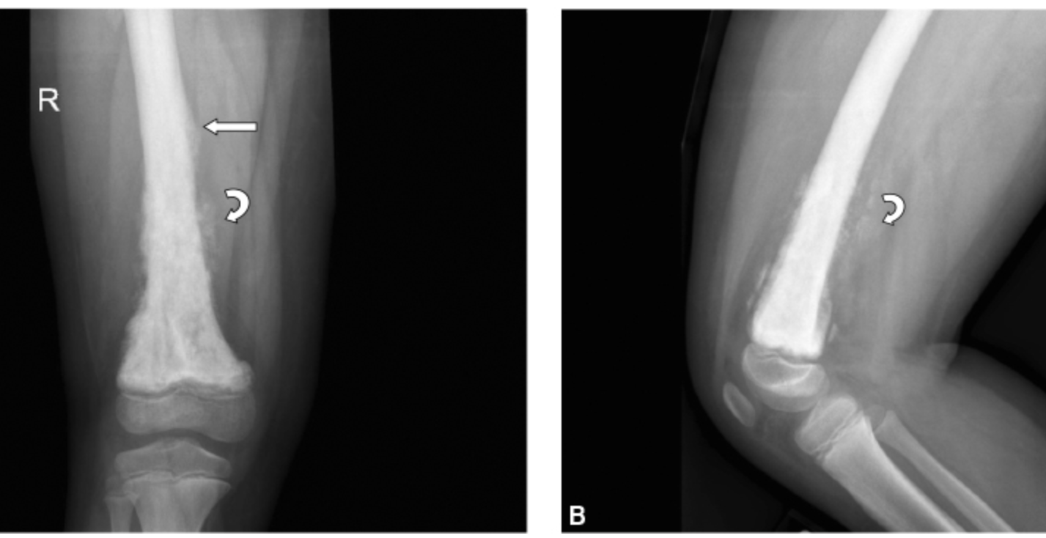
OS - Evaluation
Lesion will invariably be visualized on a plain radiograph (typically osteoblastic + osteolytic lesion)
Primary site MRI
Include coverage of entire bone to look for skip mets
Chest CT, PET/CT whole body to eval for mets
Biopsy (needle vs open) is needed to make the diagnosis
Notes:
Although osteosarcoma is not often considered the most likely diagnosis in patients presenting with leg pain, arriving at the diagnosis is greatly assisted by the fact that a lesion will invariably be visualized on a plain radiograph
distal femur demonstrating a mixed lytic and sclerotic lesion with osteoid matrix (curved arrow) and Codman triangle, which results from the soft-tissue mass breaking through the overlying ossified periosteal new bone
MRI/CT Imaging of the primary tumor should include coverage of the entire bone to look for the presence of skip lesions
Unless there is chest wall, hilar, or mediastinal involvement, the CT should be performed without intravenous contrast
differentiating benign from metastatic nodules can be difficult, particularly in areas with endemic fungal disease, such as histoplasmosis.²² The size, number, and margins of the nodules can assist in making this distinction. Sharply marginated lesions larger than 5 mm in diameter, especially when multiple, are considered to be possible metastases, whereas solitary nodules less than 5 mm with unsharp margins are thought more likely to be benign

Slide 7
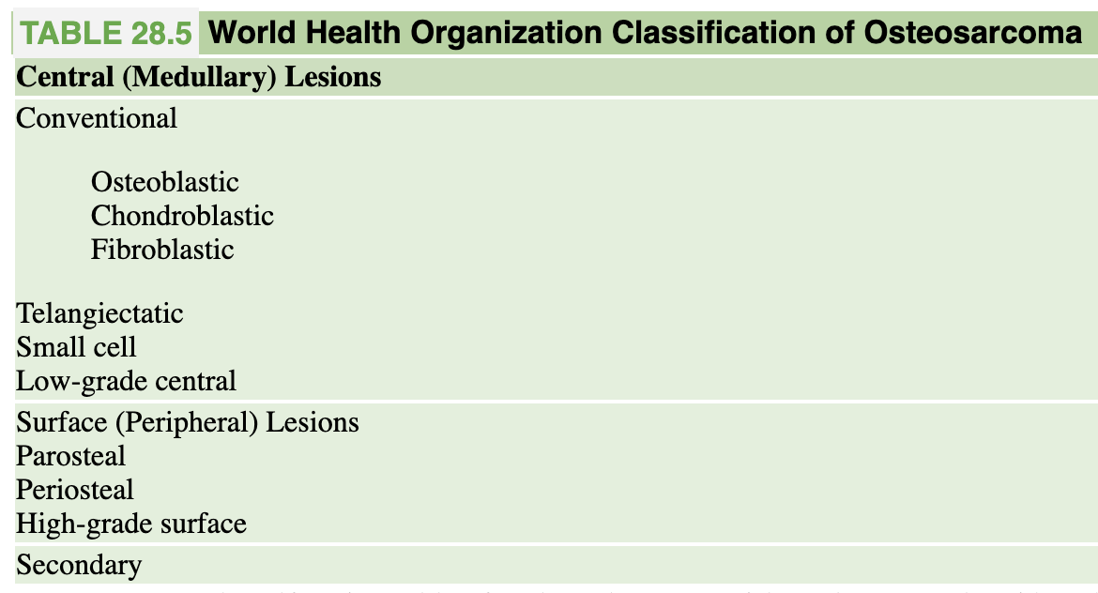
OS – Pathology
Majority are conventional (90%)
Osteosarcoma is uniformly positive for vimentin
Conventional osteosarcoma is composed of pleomorphic, obviously malignant, cells that demonstrate at least focal evidence of osteoid, a malignant bony matrix production
Pathognomonic finding: osteoid-producing malignant cells
Notes:
The histologic diagnosis of conventional osteosarcoma, which comprises the vast majority of tumors particularly in children and adolescents, is usually straightforward
Osteoblastic osteosarcoma, in which the predominant matrix is osteoblastic or bony, is the most common conventional osteosarcoma subtype.
Patients with telangiectatic osteosarcoma have a better prognosis than those with the more common conventional osteoblastic and chondroblastic subtypes.
Figure 28.8 Conventional osteosarcoma demonstrating malignant cells associated with abundant deposition of osteoid (straight arrows).

Slide 8
OS - Genetics
Majority of tumors have karyotypic abnormalities, and genetic heterogeneity between patients
Genetic lesions in the RB1 gene have been shown to be present in approximately 70% of primary osteosarcoma.
Between 50% and 90% of osteosarcomas have genomic alterations inactivating TP53
Chromosomal instability seems like a key feature in OS development
Notes:
Alterations of the RB1 and TP53 tumor suppressor pathways (Fig. 28.9) are among the most consistent features of osteosarcoma occurring both as germline and somatic events. Genetic lesions in the RB1 gene have been shown to be present in approximately 70% of primary osteosarcoma.
Between 50% and 90% of osteosarcomas have genomic alterations inactivating TP53
With many different genetic abnormalities, seems like chromosomal instability is key feature in development of OS
no demonstrated associations between osteosarcoma subtype and prognosis or response to therapy

Slide 9
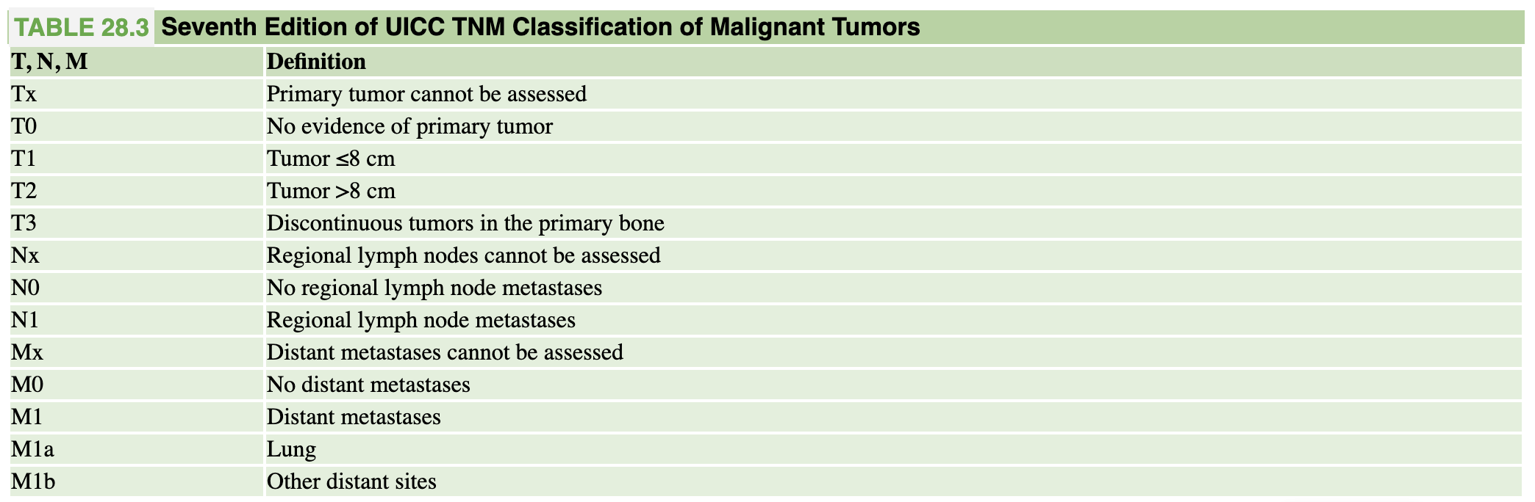
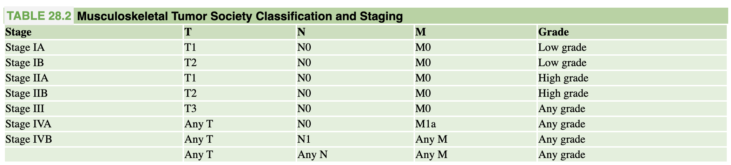
Regardless of the staging system, the vast majority of children and adolescents diagnosed with osteosarcoma will fall into two groups: (1) those with high-grade osteosarcoma with tumor radiographically evident at the primary site and (2) those with tumor radiographically visible at metastatic sites.
Notes:
Regardless of the staging system, the vast majority of children and adolescents diagnosed with osteosarcoma will fall into two groups: (1) those with high-grade osteosarcoma with tumor radiographically evident at the primary site and (2) those with tumor radiographically visible at metastatic sites.

Slide 10
OS – Treatment (Chemo)
Clinical trials in osteosarcoma conducted in the 1970s and 1980s in the United States and Europe established that methotrexate, doxorubicin, cisplatin, and ifosfamide, etoposide were active in osteosarcoma and that neoadjuvant treatment facilitated surgery without decreasing survival.
there has been little significant change in treatment approach over the past four decades
In a meta-analysis of completed clinical trials in newly diagnosed localized osteosarcoma, patients who received chemotherapy regimens containing only two drugs, usually doxorubicin and cisplatin, had poorer event-free and overall survival than those who received chemotherapy regimens containing three or more drugs
Role of XRT is typically palliative
Notes:
The outcome for patients with osteosarcoma, in the prechemotherapy era, treated with surgery and/or radiotherapy was poor with 2-year overall survivals of 15% to 20% despite adequate local control of the primary tumor.^{120,121} Following local control measures, 80% to 90% of patients developed metastatic lung disease, suggesting that most patients with apparently localized disease have microscopic lung metastases at presentation

Slide 11
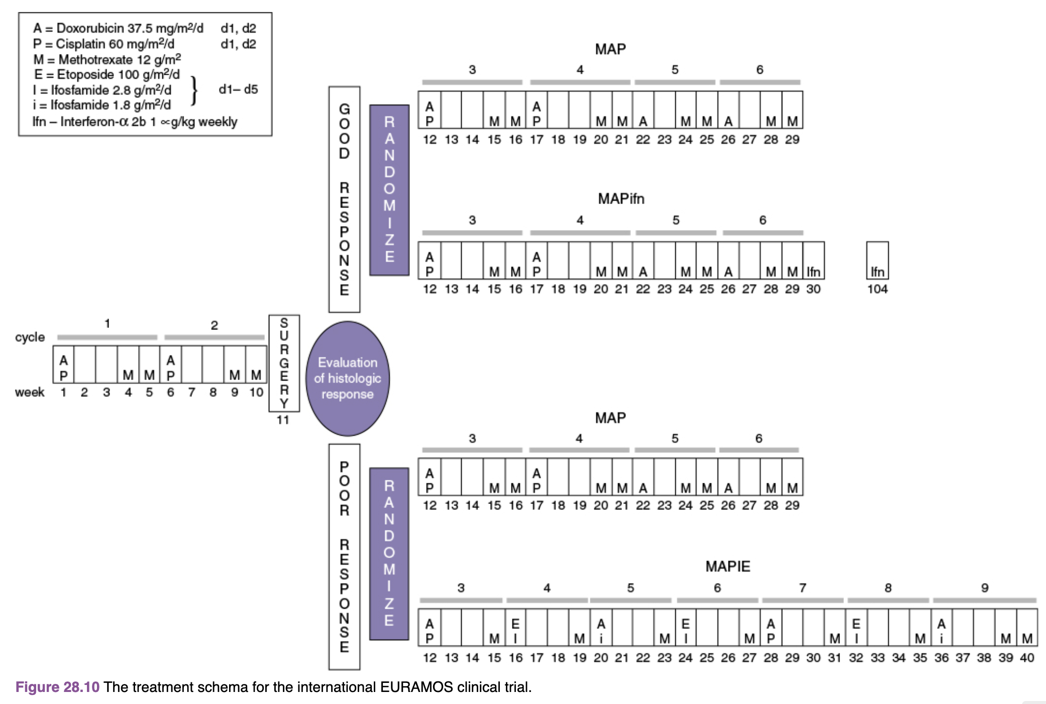
OS – roadmap
Doxo cumulative dose = 450 mg/m2/d
Notes:
Results of the good responder arm of this study demonstrated the addition of pegylated interferon, administered as maintenance treatment, did not result in a statistically significant improvement in event-free or overall survival.¹⁷⁵ For patients whose tumor showed a poor histologic response, there was not an improvement in event-free survival with the addition of ifosfamide and etoposide to the backbone chemotherapy. Of note, the rate of second malignant neoplasms, although low overall, was higher in ifosfamide and etoposide arm.
Pre-op chemo allows for starting treatment more quickly, might allow for easier resection, tumor necrosis information (though can’t really act on it)

Slide 12
OS – surgery
After a period of chemotherapy, complete surgical resection of the primary lesion is performed as the standard approach to local control as osteosarcomas are believed to be relatively radiation resistant
advances over the past three decades have made limb-salvage surgery a viable option, with similar survival outcomes when properly performed
For patients with metastatic disease, especially pulmonary metastases, surgery to remove all sites of disease must be considered.
Studies have shown that patients who were rendered free of disease surgically have a survival benefit over those whose pulmonary metastases were not completely excised

Slide 13
OS – outcomes
With modern treatment, approximately 60% to 70% of newly diagnosed, localized, resectable osteosarcoma patients can expect to be disease free 3 years from diagnosis
>90% necrosis (good responder) – 3 year EFS (localized) – 77-80%
<90% necrosis (poor responder) – 3 year EFS (localized) – 57-60%
the chances of long-term relapse-free survival are generally less than 20% in patients with more than a single isolated pulmonary nodule
The most common site of disease recurrence remains the lung, and about 20% to 30% of patients are reported to be cured by exploration and complete surgical resection of all lung metastases
Therapy-related complications include anthracycline-induced cardiomyopathy, hearing loss, kidney dysfunction, second malignancies, and sterility, especially in patients receiving alkylating agents

Slide 14
Questions? Comments? Concerns?
Osteosarcoma is the most common primary bone tumor in children
Most common primary sites are around the knee - distal femur and proximal tibia
Osteosarcoma is uniformly positive for vimentin on IHC
MAP (methotrexate, doxorubicin, cisplatin) is standard chemotherapy
All sites of disease should be resected for best chance of cure
% necrosis is prognostic indicator (90% cutoff, though more is better)
Most common site of recurrence is the lung

Slide 15
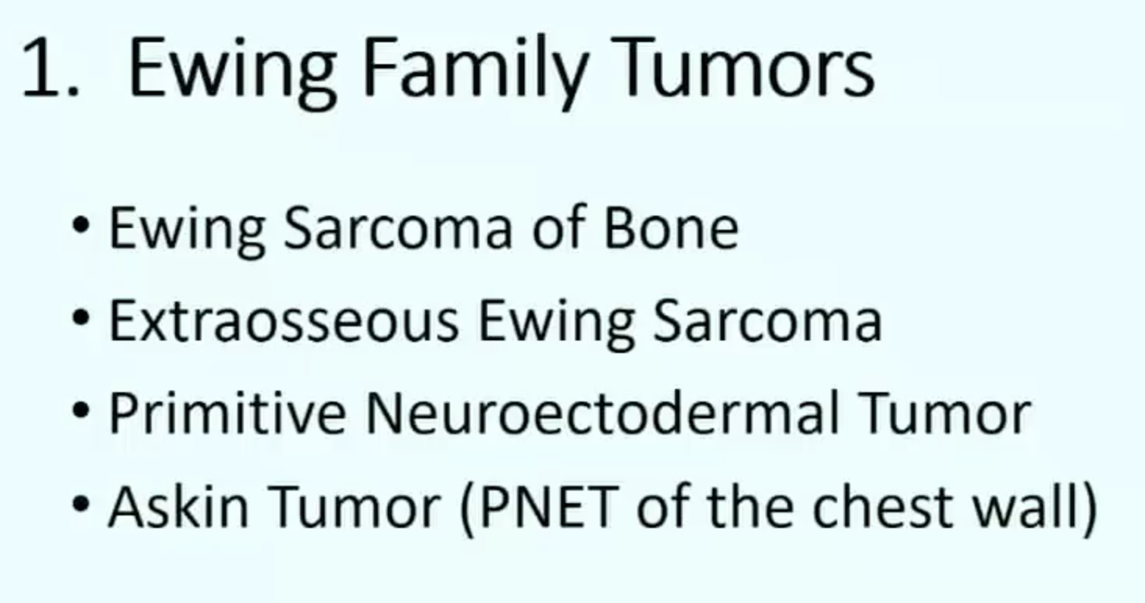
Ewing sarcoma
Notes:
Comments apply to ewing family of tumors

Slide 16
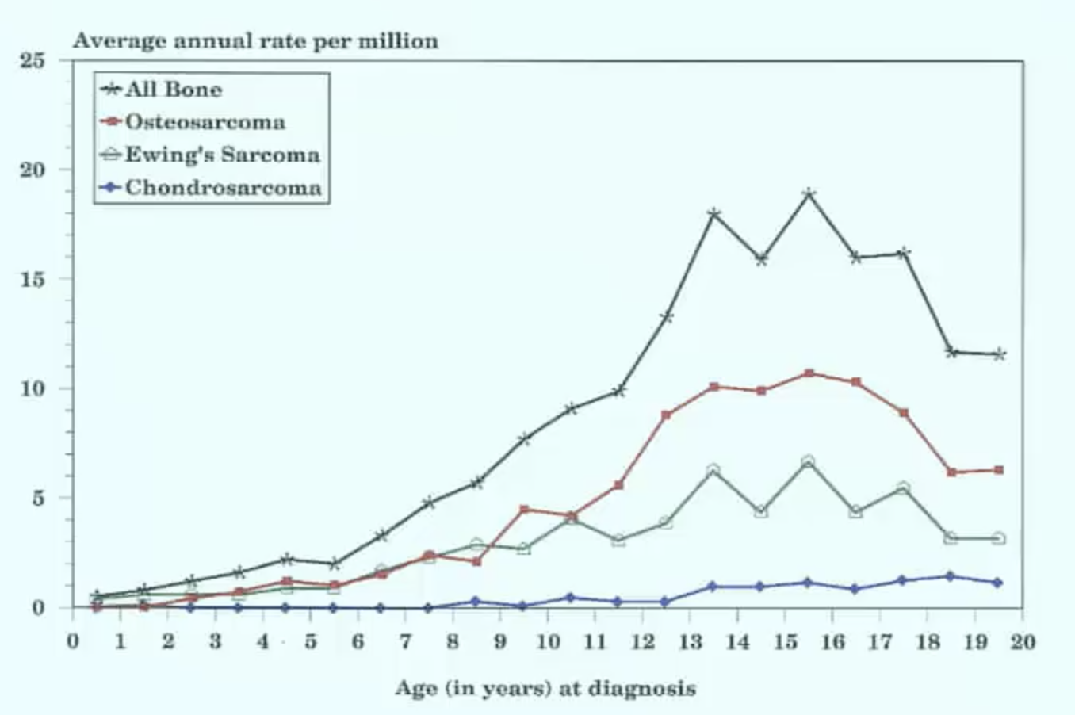
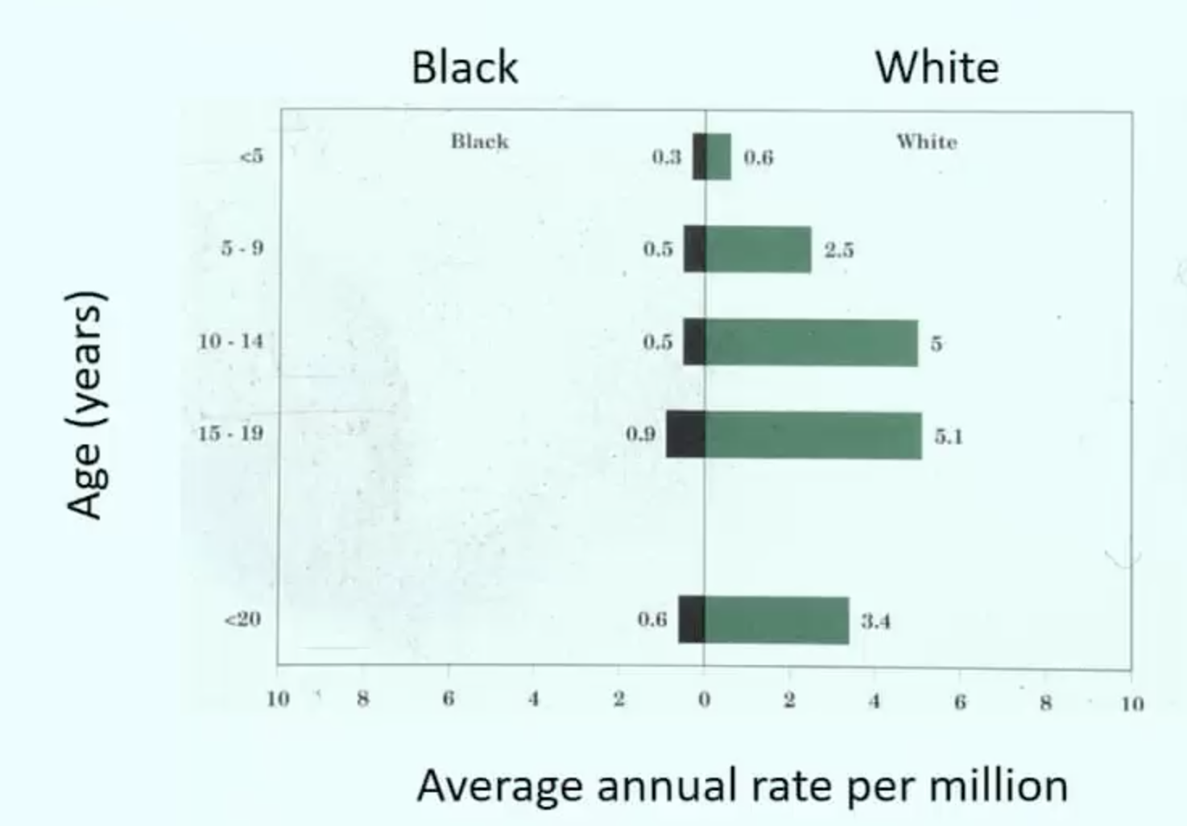
ES – epidemiology
Second most common primary bone sarcoma in children and young adults
Notes:
EWS – white children have higher rates of EWS than black children

Slide 17
ES – clinical presentation
prolonged duration of symptoms is not associated with metastases or inferior outcome
ES more likely to be in diaphysis (unlike OS, which is more likely metaphysis)
The main alternative cancer diagnosis is osteosarcoma, although lymphoma, Langerhans cell histiocytosis, and metastatic lesions from other primary cancers should be considered
Notes:
Metastases to lymph nodes, liver, or central nervous system are rare

Slide 18

ES - Genetics
The most consistent abnormality is a reciprocal chromosomal translocation between chromosomes 11 and 22, t(11;22)(q24;q12), which is present in about 85% of these tumors and is considered pathognomonic for the disease
EWSR1-FLI1 fusion
About 15% of histopathologically defined Ewing sarcoma tumors lack the classic t(11;22)(q24;q12) translocation
Notes:
EWSR1 – “fly” 1 fusion

Slide 19
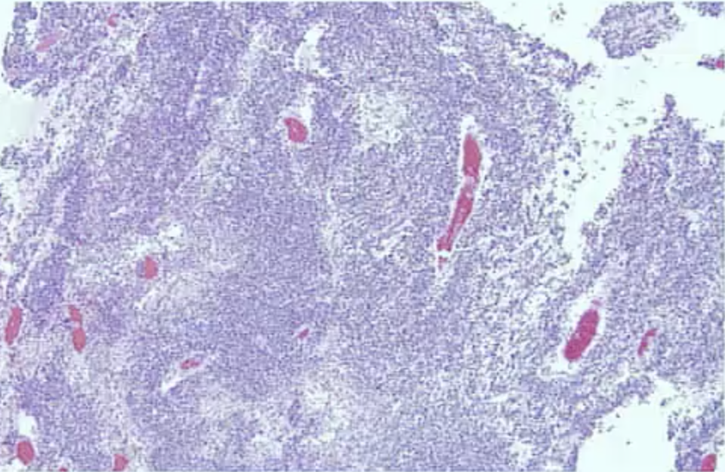
ES - Pathology
Small round blue cell tumors
CD99+, Vimentin +
ES typically undifferentiated
PNET can show neural differentiation

Slide 20
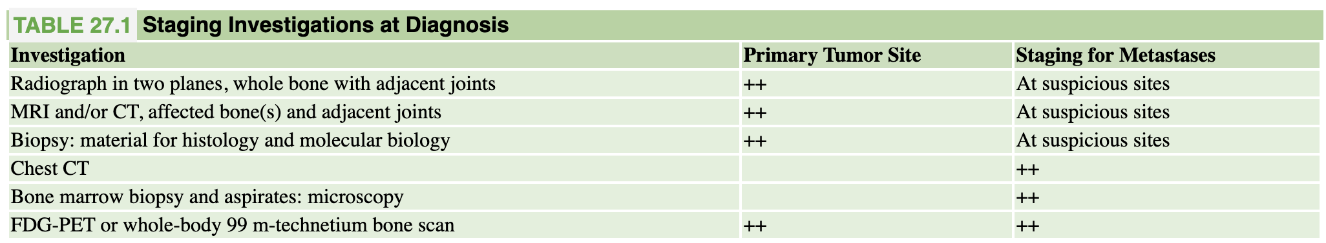
ES – workup

Slide 21
ES - Treatment
Cure from Ewing sarcoma can only be achieved with both chemotherapy and local control (surgery or radiation therapy)
Current treatment schedules favor primary induction chemotherapy, followed by local therapy and adjuvant chemotherapy
Notes:
Either get negative margins, or do XRT

Slide 22
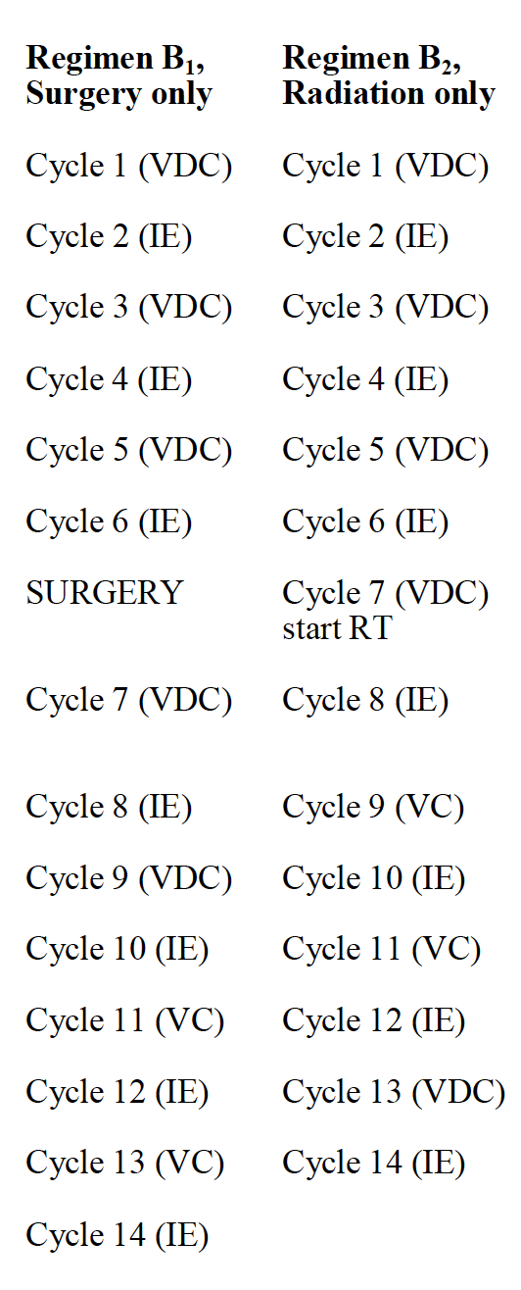
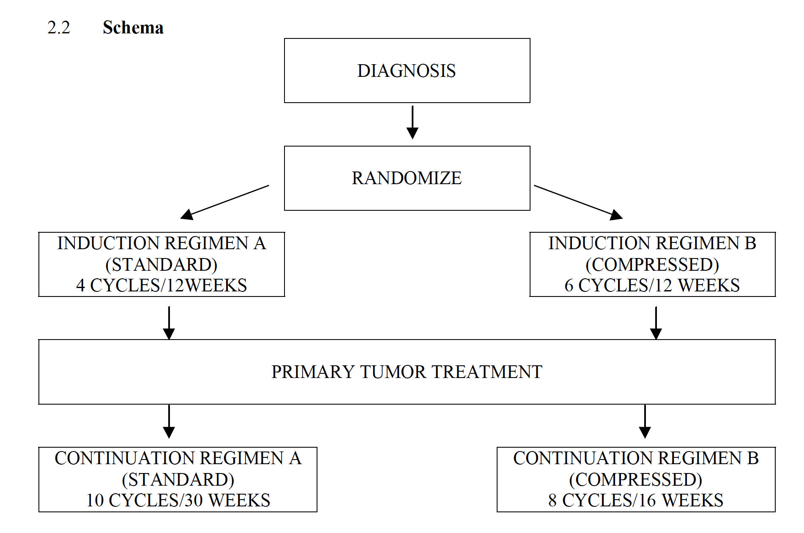
ES – chemotherapy (AEWS0031)
Doxorubicin = 75 mg/m2/cycle = 375 mg/m2 total

Slide 23
ES – local control
Surgery when possible
Debulking procedures do not improve local control and are associated with both additional unnecessary morbidity and delays in the administration of systemic therapy
Definitive radiotherapy may also be an alternative in selected subgroups of patients with small tumors that would require relatively morbid surgical procedures because of location, such as the sacrum.
To control Ewing sarcoma, a radiation dose above 40 Gy is necessary.
Whole lung irradiation for pulm mets
During radiotherapy, dactinomycin and doxorubicin should be omitted because of known radiosensitization

Slide 24
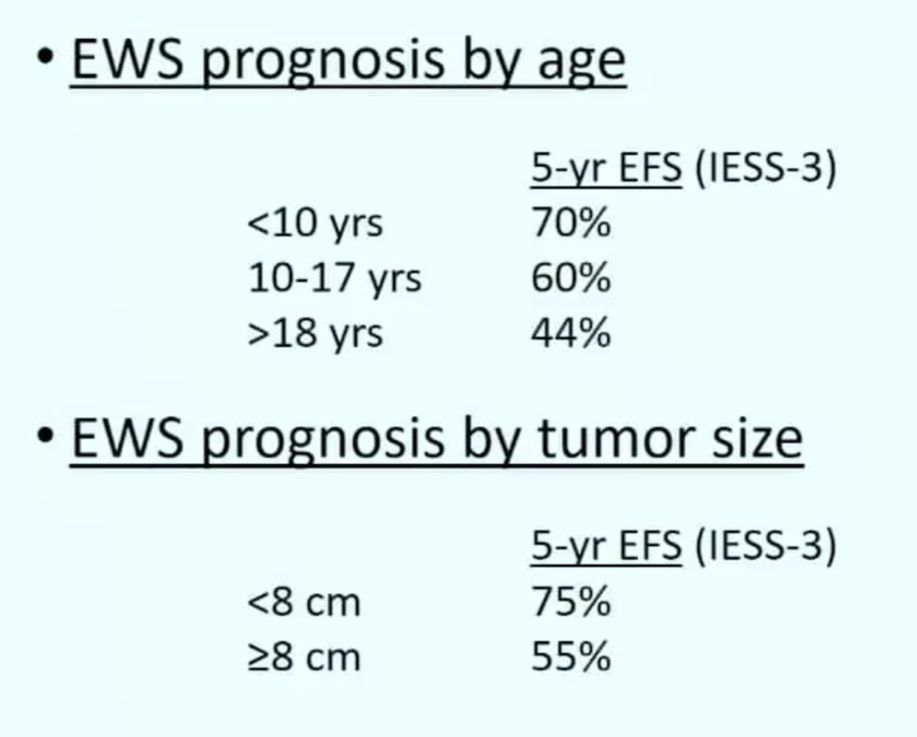
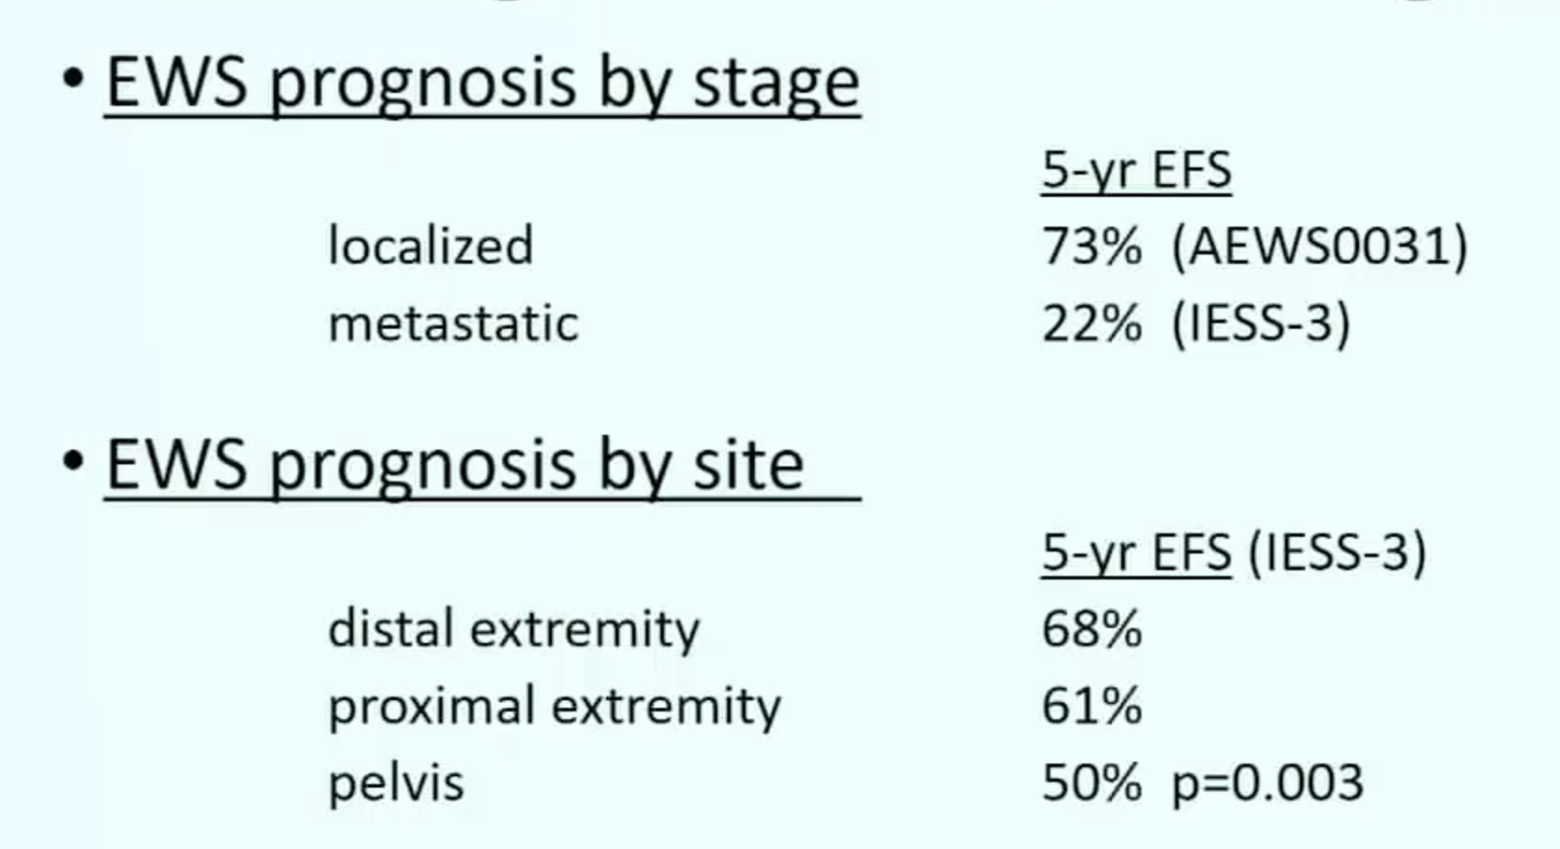
ES - outcomes
Notes:
Multivariate analysis of pediatric patients treated for Ewing sarcoma of the bone found that the only variables associated with poorer outcome were age older than 14 years, lack of complete response on imaging, tumor volume greater than 150 mL, and development of distant disease.⁵⁶ A meta-analysis of pediatric and adult patients reported that worse outcomes were associated with metastasis at diagnosis, large tumors, primary site in the axial skeleton, and histologic response less than 100%
The presence of metastatic disease at initial diagnosis is currently the most important adverse prognostic factor.^{73,82,126,127} Patients with isolated lung metastases have a better prognosis than those with extrapulmonary metastases

Slide 25
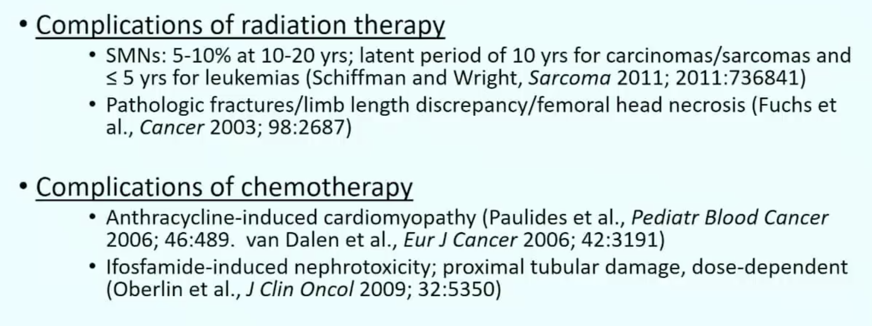
ES – Complications and late effects

Slide 26
ES – Complications and late effects
As with the other sarcomas, relapse has poor prognosis

Slide 27
Questions? Comments? Concerns?
EWSR1-FLI1 fusion “Patrick Ewing looks fly!”
Most common primary sites are pelvis, femur, ribs
IE-VDC is standard chemotherapy
XRT and surgery are both effective for local control

Slide 28
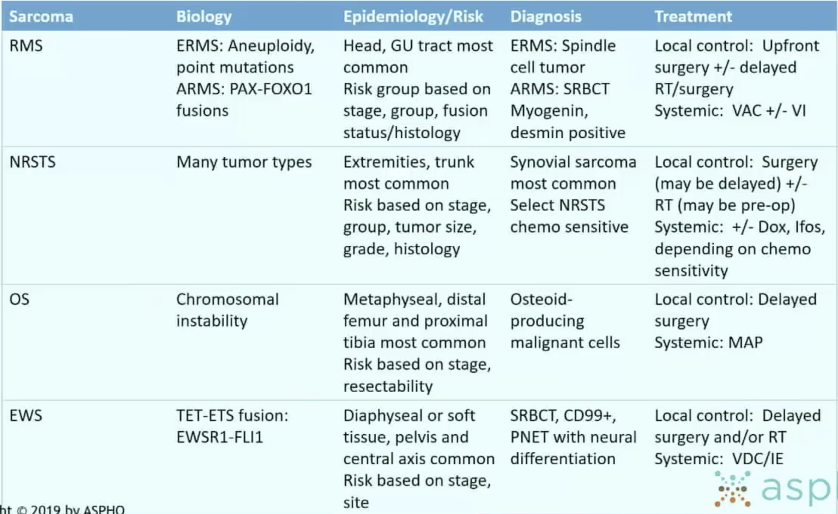
Summary
Notes:
NRST – nonrhabdo soft tissue sarcoma

